Slide 1



The Power and Lies of A/B Testing
The Power and Lies of AB Testing
Professor Dave Hardisty

Slide 2











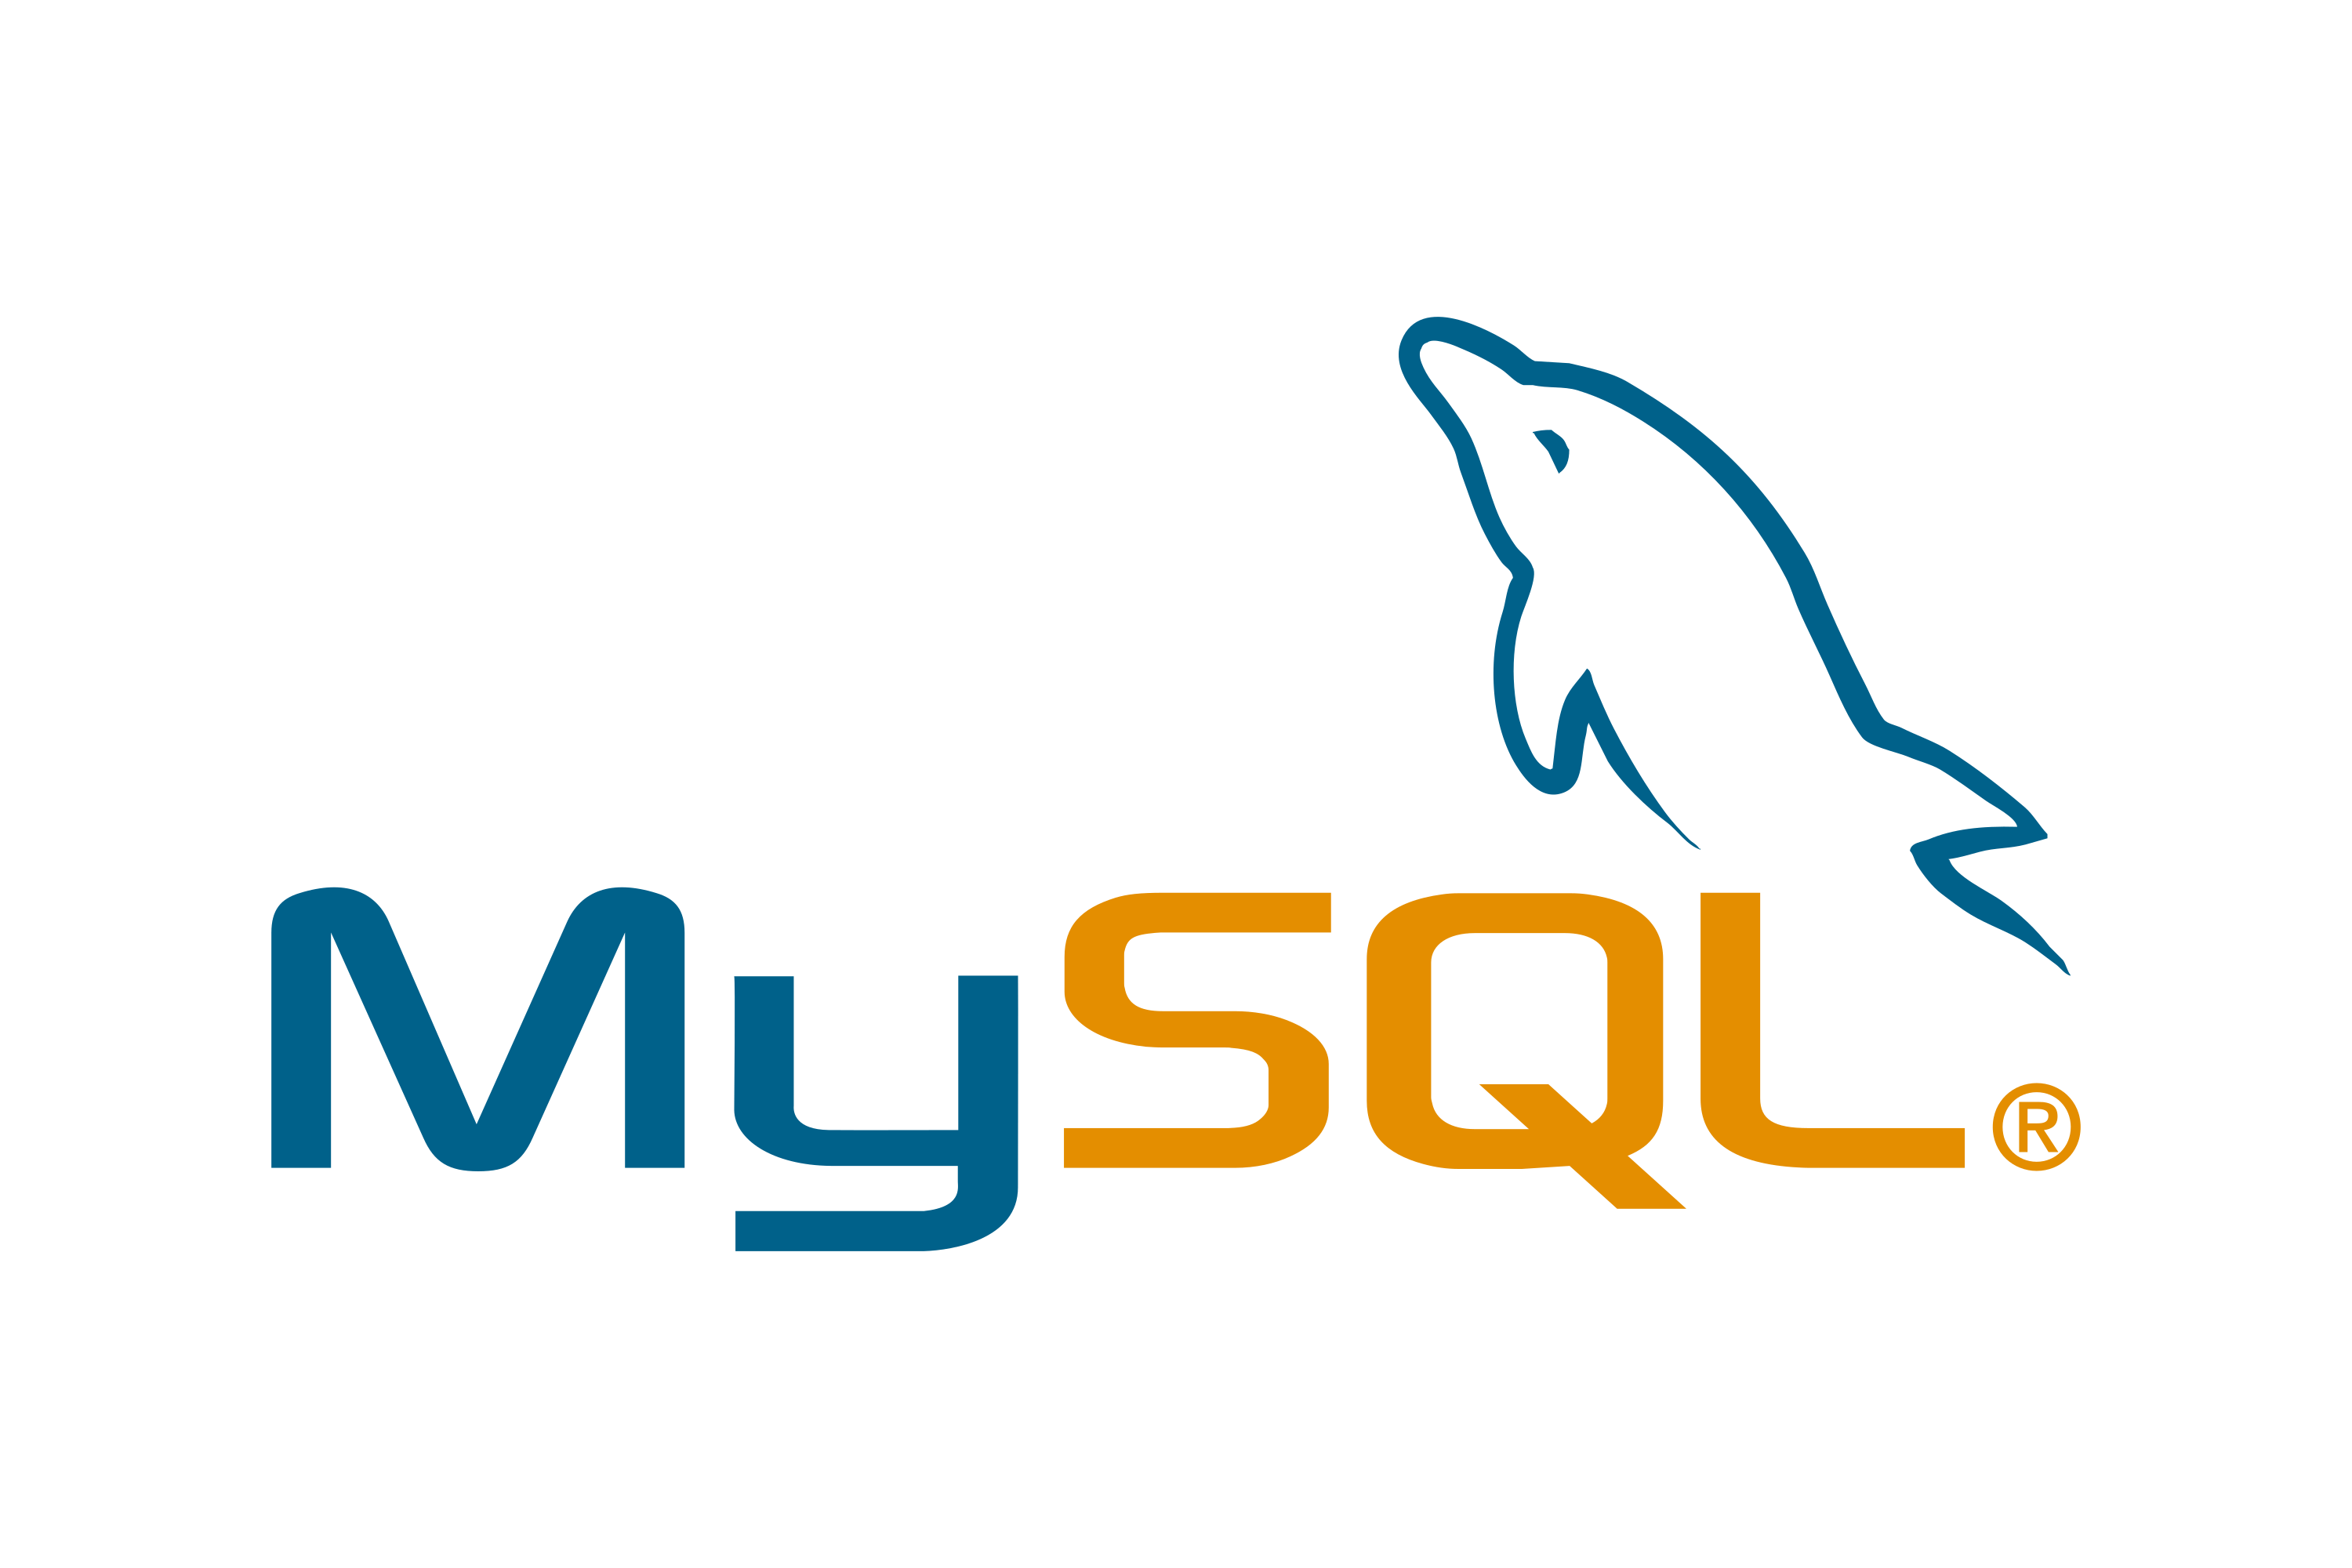











Dave Hardisty, PhD
Marketing & Behavioural Science
Notes:
Land acknowledgment

Slide 3
Today’s Agenda
The Power of AB Testing
What is an AB Test
Creating an AB Test
When & why to use AB Testing
Causal Inference
Break
The Lies of AB Testing
Boegershausen, J., Cornil, Y., Yi, S., & Hardisty, D. J. (2025). On the Persistent Mischaracterization of Google and Facebook A/B Tests: How to Conduct and Report Online Platform Studies. International Journal of Research in Marketing.
Simmons, J. P., Nelson, L. D., & Simonsohn, U. (2011). False-positive psychology: Undisclosed flexibility in data collection and analysis allows presenting anything as significant. Psychological science, 22(11), 1359-1366.
AB Test Results
The future of AB Testing

Slide 4
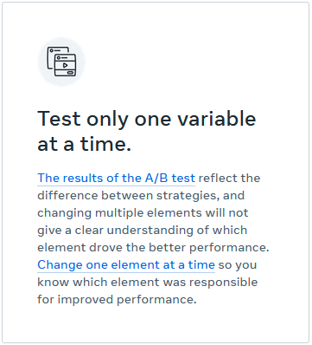
What is AB Testing?
AB Tests compare the effectiveness of changing one thing, while holding everything else constant
Great for CRO = Conversion Rate Optimization
Have any of you used AB Testing?
https://www.facebook.com/business/ads/ab-testing#how-it-works
Notes:
CRO = Conversion Rate Optimization
Today, a lot of marketing experimentation is done on the digital space. Why the digital space is idea for experimentation? There are 2 reasons:
1-We can « see » more of the shopping and purchase process in the digital space than in other media. An ad, a campaign, has a direct impact on clicking and purchase behavior – you can track a purchase to a clickable ad. You cans ee intermediary steps between ads and purchase. IN TV you put the ad, you can kind of see what sales will be afterwards, but you don’t have precise measurement
2-We can send different marketing messages to individual customers. I can send one email to half you (picked randomly), and another email to the other half. That gives control + random allocation.
Perfect for experimentation. This was literally impossible before. That’s why we see explosion in experimentation online.

Slide 5


What is AB Testing?
Facebook A/B Test
CTR = 0.88% CTR = 1.13%
p < .001

Slide 6

Example email A/B test setup
Source: Zapier.com blog
The purpose of AB Testing is to learn, and then scale up.
Notes:
Zapier is a product that allows end users to integrate the web applications they use and automate workflows. The company is fully remote. As of 2021, it connects to more than 4,000 apps,^{[2]} with free and paid plans.[

Slide 7
Examples of Website experiments
Simple A/B test experiments
Randomly assigning vistors to one version of the website or a variation, and analyzing the impact on time spent, purchase, etc., in order to find the best version for all users.
e.g. Kameleoon
Complex AI-based optimization
Constant and automatic experimentations on visitors in order to find the best version for each individual visitor (complete personalization).
e.g. Adobe Target
https://www.youtube.com/watch?v=2ZwsBWVAJeQ&feature=emb_logo
https://www.youtube.com/watch?v=pfDNq1W0R5Y
https://www.youtube.com/watch?v=TtxeKJZUYcg
Notes:
Websites – online stores, web based services
Intermediary steps in shopping=e.g. putting product in cart
Plento of tools available

Slide 8
Example of Public Interest Marketing
Hall, J. D., & Madsen, J. M. (2022). Can behavioral interventions be too salient? Evidence from traffic safety messages. Science, 376(6591), eabm3427.
Notes:
https://papers.ssrn.com/sol3/papers.cfm?abstract_id=3633014

Slide 9
AB Testing in Digital Marketing
Testable Features (X’s):
Headlines
Calls to action button
Endless creative features
Ad Placement on webpage
Page layout
Target audience
Measurable outcomes (Y’s):
Time on site
Clicks/Clikthrough rate
Bounce Rate (leave after visiting 1 page)
Conversion
Email sign-up
Revenue / ROI
Plenty of tools to experiment and optimize your website/online ads, e.g.
Google Optimize / Optimize 360
Adobe Target
Optimizely
Visual Website Optimizer (VWO)
Unbounce
Kissmetrics
Social media and e-commerce platforms also offer A/B Testing Solutions:
Meta (Facebook/Instagram)
Amazon
TikTok
LinkedIn
Notes:
Websites – online stores, web based services
Intermediary steps in shopping=e.g. putting product in cart
Plento of tools available

Slide 10


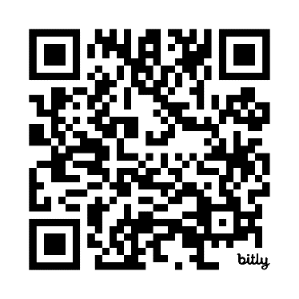
Creating an AB Test
Time for a little competition! Test your sales skills.
You are selling WhiteCaps tickets for the upcoming playoff game November 22 at BC Place against LAFC
Tickets are normally $39.49 each
You will design a 1-page advertisement, which will be seen by ~50 Canadians (using Prolific.co)
Survey takers will be told to imagine they live in Vancouver, see one of the ads (a “between subjects design”), and say how many tickets they would buy (from 0 to 8 tickets)
Your goal for this competition is to maximize expected revenue (number of tickets x price per ticket). You can change the price, title, text, etc, but you cannot change the image or the event details. Work on google slides: http://bit.ly/4hFDdpz

Slide 11
Why Use AB Testing?
AB Testing can tell us:
How effective is this marketing action? (ROI)
For this we often use a “hold out test”
Which marketing action is more effective?
What is the critical ingredient for causal impact? (“I know half my marketing budget is wasted, but I don’t know which half”)
Notes:
Today, a lot of marketing experimentation is done on the digital space. Why the digital space is idea for experimentation? There are 2 reasons:
1-We can « see » more of the shopping and purchase process in the digital space than in other media. An ad, a campaign, has a direct impact on clicking and purchase behavior – you can track a purchase to a clickable ad. You cans ee intermediary steps between ads and purchase. IN TV you put the ad, you can kind of see what sales will be afterwards, but you don’t have precise measurement
2-We can send different marketing messages to individual customers. I can send one email to half you (picked randomly), and another email to the other half. That gives control + random allocation.
Perfect for experimentation. This was literally impossible before. That’s why we see explosion in experimentation online.

Slide 12
When to Use AB Testing?
AB Testing = Knowledge, but it also has costs
When is it especially useful?
You can scale from a small test to a big rollout
You can generalize learnings from one situation to another
You can iterate quickly
Or: it’s really important to get something right
Notes:
Today, a lot of marketing experimentation is done on the digital space. Why the digital space is idea for experimentation? There are 2 reasons:
1-We can « see » more of the shopping and purchase process in the digital space than in other media. An ad, a campaign, has a direct impact on clicking and purchase behavior – you can track a purchase to a clickable ad. You cans ee intermediary steps between ads and purchase. IN TV you put the ad, you can kind of see what sales will be afterwards, but you don’t have precise measurement
2-We can send different marketing messages to individual customers. I can send one email to half you (picked randomly), and another email to the other half. That gives control + random allocation.
Perfect for experimentation. This was literally impossible before. That’s why we see explosion in experimentation online.

Slide 13
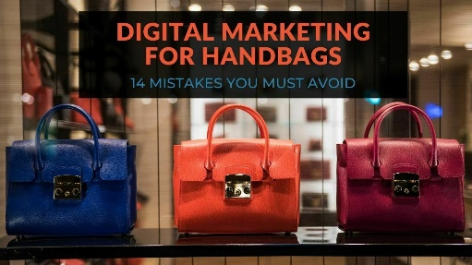

Is an A/B Test Really Necessary?
Random Assignment (holdout test)
TaskaBella
96%
DV=
Conversion
(percentage of unique exposed users who made a purchase)
Ad bidding for
targeted users
on selected websites
Ad
4%
Control

Slide 14
Is an A/B Test Really Necessary?
Mr. Skeptical, marketing manager at TaskaBella, argues the following:
« Wait a minute, I don’t think it’s necessary to pay for the control ad. In an online environment, an A/B test is not necessary to compute the ROI of a campaign. Based on cookies and unique IDs, we can track whether people exposed to the Taskabella ad will eventually purchase the handbag. So we can easily compute the ROI of the Taskabella ad, based on the CPM of this ad, and based on the revenue generated by the customers who were exposed to the ad ».
What would you reply to Mr. Skeptical in order to defend the idea of having a control ad? What's the flaw in Mr. Skeptical's reasoning?

Slide 15
Making Causal Claims
AB Testing
Randomized
Experiments
Quasi-
Experiments
Informal
Tests
Notes:
CRO = Conversion Rate Optimization
Today, a lot of marketing experimentation is done on the digital space. Why the digital space is idea for experimentation? There are 2 reasons:
1-We can « see » more of the shopping and purchase process in the digital space than in other media. An ad, a campaign, has a direct impact on clicking and purchase behavior – you can track a purchase to a clickable ad. You cans ee intermediary steps between ads and purchase. IN TV you put the ad, you can kind of see what sales will be afterwards, but you don’t have precise measurement
2-We can send different marketing messages to individual customers. I can send one email to half you (picked randomly), and another email to the other half. That gives control + random allocation.
Perfect for experimentation. This was literally impossible before. That’s why we see explosion in experimentation online.

Slide 16
Making Causal Claims
Correlation = Two variables share some kind of relationship
Causation = One variable causes something to happen in another variable
CORRELATION CAN BE EXPLAINED BY:
1. One-way causality : one variable is the cause of the other one
Reverse causality: one-way causality in the other direction
2. Two-way causality : both variables may be the cause of each other
3. A “confound”, or third variable may be responsible for the correlation
4. Spurious correlation: A mathematical relationship in which two events or variables have no causal connection.
Correlation
Causation
X
Y
X
Y
X
Y
Z
X
Y
X
Y

Slide 17
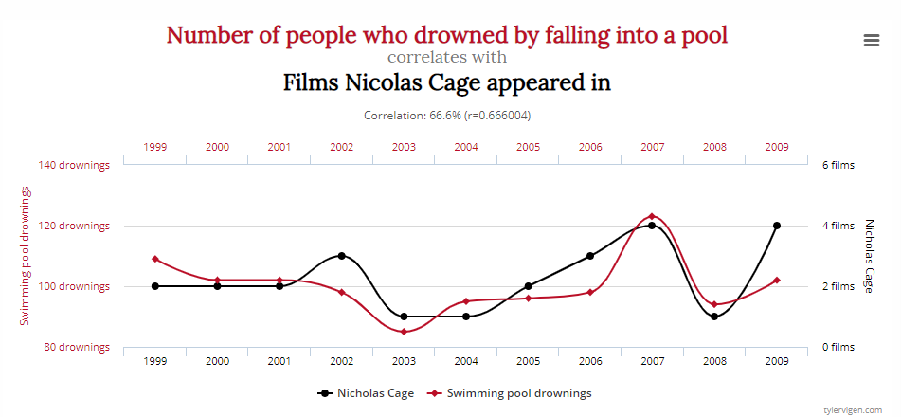
Making Causal Claims
Examples
One/Two Way Causality?
Confounds?
Spurious Correlation?
Spurious
N. Cage
drownings
http://tylervigen.com/spurious-correlations

Slide 18
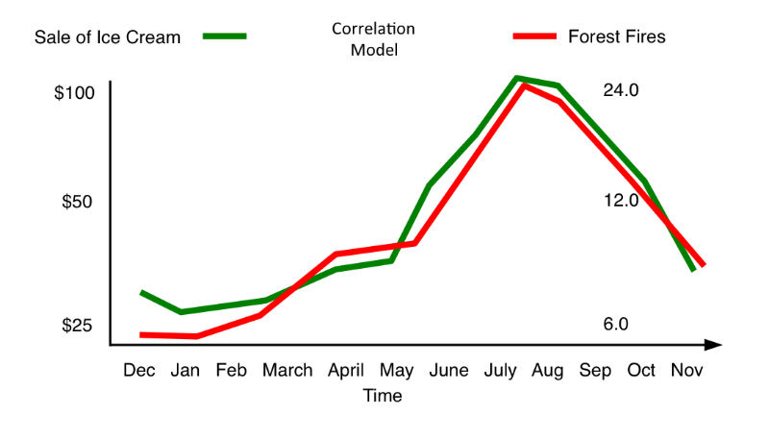
Making Causal Claims
Examples
One/Two Way Causality?
Confounds?
Spurious Correlation?
Weather
Confound
Ice cream
Fires

Slide 19

Making Causal Claims
Examples
One/Two Way Causality?
Confounds?
Spurious Correlation?
“Watching too much TV is bad for health!”
A survey of 1,254 people found that heavy television viewers were more likely than others to experience headaches, backaches, and joint pains.
e.g. Demog., Socioeco.
Reverse causality
(in the other direction as suggested)
Confounds
Pain
TV

Slide 20

Making Causal Claims
Examples
One/Two Way Causality?
Confounds?
Spurious Correlation?
“Energy drinks make people aggressive!”
A survey of 500 university students found heavy energy drinks consumers tended to have more aggressive personality traits, and to behave aggressively (e.g., making threats, being rude) in competitive games.
e.g. Demog., Socioeco, personality
Confounds
Energy drinks
Aggressive
Notes:
e.g., men
RED CAR & INSURANCE

Slide 21

Making Causal Claims
Examples
One/Two Way Causality?
Confounds?
Spurious Correlation?
The instructors in a flight school adopted a policy of consistent positive reinforcement recommended by psychologists: they praised each successful execution of a complex flight maneuver (100% success). The instructors then claimed that contrary to psychological doctrine, high praises resulted in a decrease in performance on the next try.
Regression toward the mean = if a sample point of a random variable is extreme (nearly an outlier), a future point will be closer to the mean or average on further measurements.

Slide 22
Making Causal Claims
Examples
One/Two Way Causality?
Confounds?
Spurious Correlation?
The instructors in a flight school adopted a policy of consistent positive reinforcement recommended by psychologists: they praised each successful execution of a complex flight maneuver (100% success). The instructors then claimed that contrary to psychological doctrine, high praises resulted in a decrease in performance on the next try.
Regression toward the mean = if a sample point of a random variable is extreme (nearly an outlier), a future point will be closer to the mean or average on further measurements.
High Perf at t0
Confound
Praise
Lower Perf at t1

Slide 23
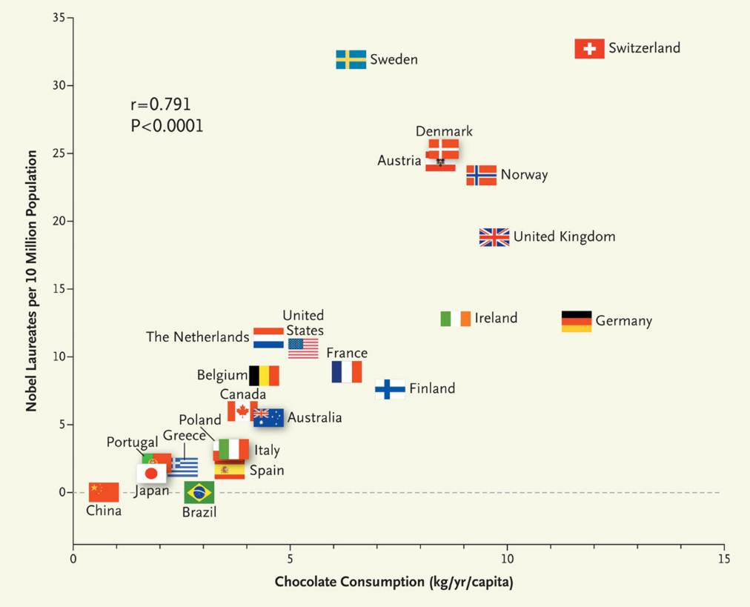

Making Causal Claims
Examples
Messerli, F. H. (2012). Chocolate consumption, cognitive function, and Nobel laureates. New England Journal of Medicine, 367(16), 1562-1564.
How would you test the causal effect of eating chocolate on cognitive function?

Slide 24
Is This an Experiment?
Suppose that researchers want to study whether pets provide therapeutic benefits for their owners. Specifically, they decide to investigate whether heart attack patients who own a pet tend to recover more often than those who do not. They randomly select a sample of heart attack patients from a large hospital, determine which have pets, and then check up on them after one year. The researchers compare the proportion of their subjects who have survived and find that 92% of those with pets are still alive while only 64% of those without pets have survived.
Is this an experiment or an observational study?
2. Can you conclude that pets played a significant role in the survival of heart attack patients? Are there confounds?
There is a comparison group, but we cannot conclude causality because participants are not randomly given a dog versus not (so it’s not an experiment). Participants chose whether to get the treatment (i.e., the dog), it is called a self-selected sample. Self-selection leaves the door open to all sorts of confounds.
Source: https://twp.duke.edu/sites/twp.duke.edu/files/cexer.pdf

Slide 25
Break Time!
Start Again at 8:23

Slide 26
Agenda
The Power of AB Testing
What is an AB Test
Creating an AB Test
When & why to use AB Testing
Causal Inference
Break
The Lies of AB Testing
Boegershausen, J., Cornil, Y., Yi, S., & Hardisty, D. J. (2025). On the Persistent Mischaracterization of Google and Facebook A/B Tests: How to Conduct and Report Online Platform Studies. International Journal of Research in Marketing.
Simmons, J. P., Nelson, L. D., & Simonsohn, U. (2011). False-positive psychology: Undisclosed flexibility in data collection and analysis allows presenting anything as significant. Psychological science, 22(11), 1359-1366.
The results of our own AB Test
The future of AB Testing

Slide 27
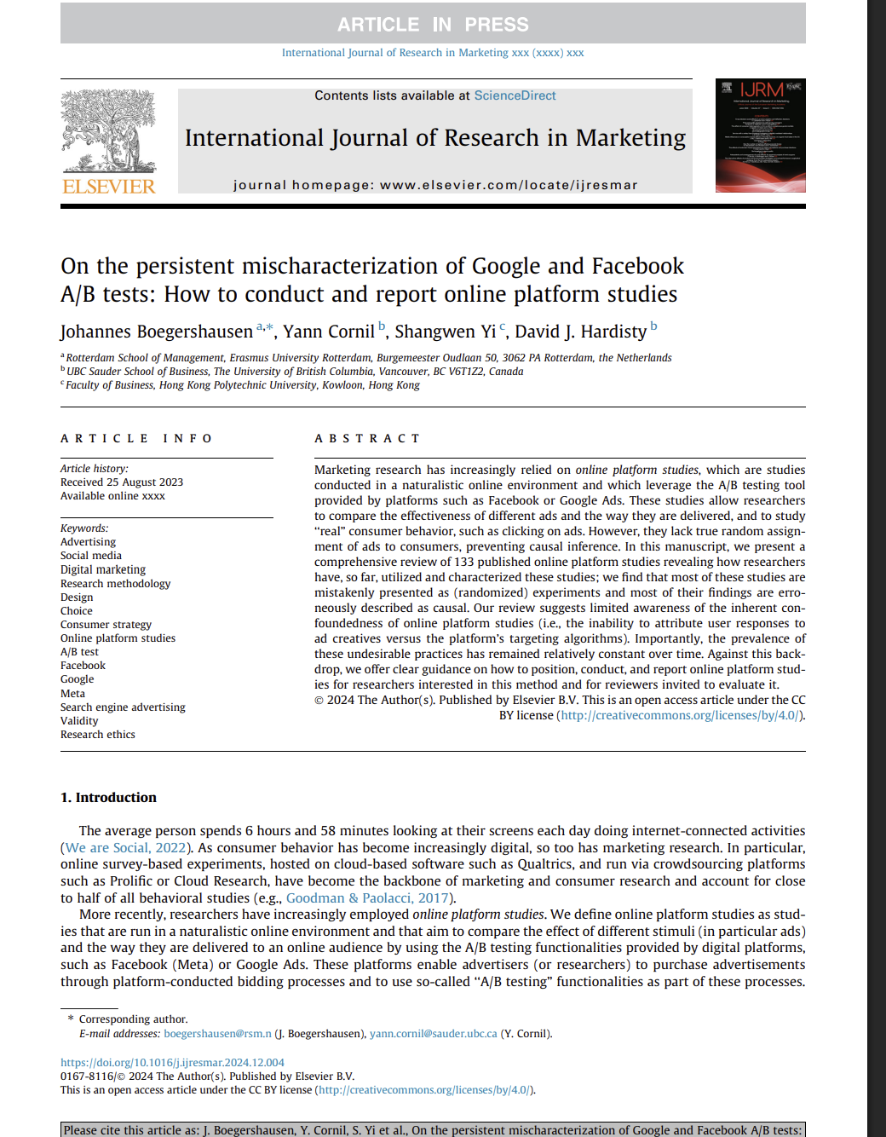
Facebook “Experiments”

Slide 28



Co-authors
Johannes Boegershausen
Yann Cornil
Shangwen Yi
Rotterdam School of Management
University of British Columbia
Hong Kong Polytechnic University

Slide 29

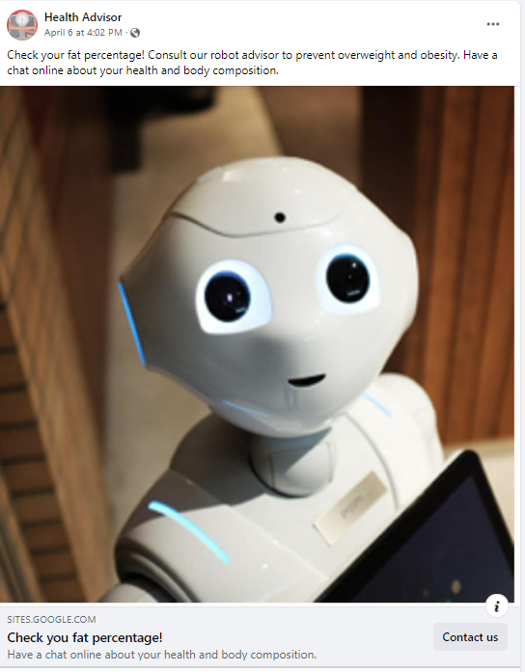
Online Platform Studies Example: Human vs Robot Doctor

Slide 30
Online Platform Studies (OPS)
Often labelled as “AB Tests”, but this is an ambiguous, umbrella category
OPS Definition: studies that are run in a naturalistic online environment and that aim to compare the effect of different stimuli (in particular ads) and the way they are delivered to an online audience, by using the A/B testing functionalities provided by digital platforms, such as Facebook (Meta) or Google Ads
Distinct from:
Holdout (or “lift”) tests – examine effect of advertisement exposure vs no exposure
Fully controlled randomized controlled trials (RCTs) run in partnership with an organization

Slide 32
Online Platform Studies: Why use them?
The average person spends 6 hours and 58 minutes looking at their screen each day doing internet-connected activities (We are Social 2022)
Marketers are keen to test their theories in online field studies with large and diverse samples
Online advertising platforms such as Facebook (Meta), Google, and Tiktok offer convenient “AB Testing” tools at a reasonable cost
“A/B Testing helps ensure your audiences will be evenly split and statistically comparable” - Meta
https://www.facebook.com/business/ads/ab-testing#how-it-works

Slide 33
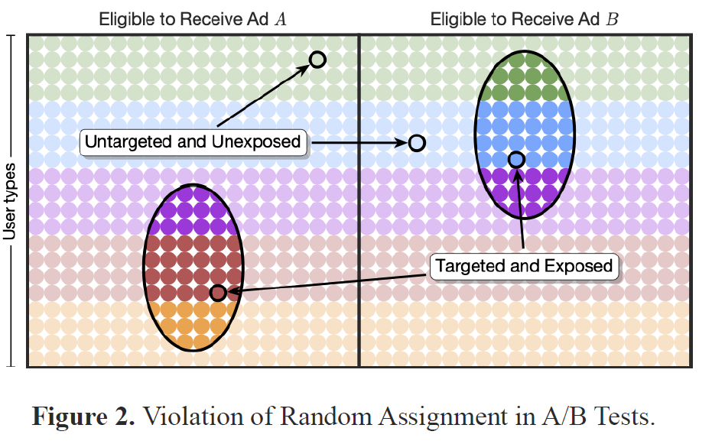
Facebook “Experiments”
Facebook A/B Test (or split test)
Divergent delivery = The platform selects different types of users across ads, based on expected user reaction and bid amount.
→ Ad A + Target Optimization A vs. Ad B + Target Optimization B
Notes:
Issue: different targeting algorithms will result in different user types across ads (confound!)

Slide 34
OPS: Internal Validity Issues
“Divergent delivery” compromises internal validity, so we cannot make clean causal inferences
OPS cannot replace a fully-random experiment!
User reactions may change the stimuli
OPS are constantly changing “black boxes”
Meaning of clicks is ambiguous
Often violates independent sampling assumptions of common statistics

Slide 35


OPS Case Example: Holthöwer & van Doorn (2022)
Research question: are people more interested in robot service providers for embarrassing topics?
Study 2: Facebook AB Test, N (“reach”) = 11,815; United Kingdom ages 18-65+
2x2 Between-Participants Design:
High Embarrassment: Check your fat percentage! Consult our robot (human) advisor to prevent overweight and obesity. Have a chat online about your health and body composition.
Low Embarrassment: Check your fat percentage! Consult our robot (human) advisor to assess your fitness and nutritional diet. Have a chat online about your health and body composition.
Holthöwer, J., & van Doorn, J. (2023). Robots do not judge: service robots can alleviate embarrassment in service encounters. Journal of the Academy of Marketing Science, 51(4), 767-784.
Notes:
Has 76 citations as of May 28, 2024

Slide 36
Holthöwer & van Doorn (2022): Click-Through-Rates
“High Embarrassment” (“prevent overweight and obesity”) | 0.74% | 1.26%
“Low Embarrassment” (“assess your fitness and nutritional diet”) | 0.73% | 0.93%
p = .037
p = .37

Slide 37
How Much Effect Does Optimization Have? Case Study of Replication and Robustness

Slide 38
Replication and Extension of Holthöwer & van Doorn (2022)
We launched three distinct A/B tests launched simultaneously on Meta, over a three-day period
Each test compared Robot Ad vs Human Ad (high embarrassment conditions only)
Optimized on “Link Clicks” vs “Impressions” vs “Reach with frequency cap”
Budget of USD 200 per test (i.e., USD 100 per ad)
Total N (impressions) = 267,151, USA, all ages
Pre-registered: https://aspredicted.org/D2B_DT8

Slide 39
Results: Click-Through-Rates
 | Clicks |  | Impression |  | Reach w/ Cap
Ad Version | Human | Robot | Human | Robot | Human | Robot
Impressions | 11,874 | 11,735 | 62,581 | 61,808 | 59,554 | 59,599
Reach | 8,760 | 9,268 | 25,400 | 24,208 | 59,345 | 59,056
Unique Link Clicks | 120 | 152 | 23 | 23 | 22 | 29
CTR1 (Unique Link Clicks/Impression) | 1.01% | 1.30% | 0.04% | 0.04% | 0.04% | 0.05%
CTR2 (Unique Link Clicks/Reach) | 1.37% | 1.64% | 0.09% | 0.10% | 0.04% | 0.05%
p=.04

Slide 40
Results: Divergent Delivery
 | Clicks |  | Impression |  | Reach w/ Cap
Ad Version | Human | Robot | Human | Robot | Human | Robot
Frequency (Impression/Reach) | 1.36 | 1.27 | 2.46 | 2.55 | 1 | 1.01
Proportion of Women among exposed | 52.3% | 38.5% | 35.3% | 29.5% | 34.0% | 31.5%
CTR1 among men | 0.98% | 1.34% | 0.04% | 0.04% | 0.03% | 0.04%
CTR1 among women | 1.02% | 1.24% | 0.04% | 0.03% | 0.04% | 0.05%
Average age of exposed users | 62.11 | 62.71 | 54.06 | 53.41 | 53.5 | 53.85

Slide 41
Results: Divergent Delivery
 | Clicks |  | Impression |  | Reach w/ Cap
Ad Version | Human | Robot | Human | Robot | Human | Robot
Frequency (Impression/Reach) | 1.36 | 1.27 | 2.46 | 2.55 | 1 | 1.01
Proportion of Women among exposed | 52.3% | 38.5% | 35.3% | 29.5% | 34.0% | 31.5%
CTR1 among men | 0.98% | 1.34% | 0.04% | 0.04% | 0.03% | 0.04%
CTR1 among women | 1.02% | 1.24% | 0.04% | 0.03% | 0.04% | 0.05%
Average age of exposed users | 62.11 | 62.71 | 54.06 | 53.41 | 53.5 | 53.85

Slide 42
Results: Divergent Delivery
 | Clicks |  | Impression |  | Reach w/ Cap
Ad Version | Human | Robot | Human | Robot | Human | Robot
Frequency (Impression/Reach) | 1.36 | 1.27 | 2.46 | 2.55 | 1 | 1.01
Proportion of Women among exposed | 52.3% | 38.5% | 35.3% | 29.5% | 34.0% | 31.5%
CTR1 among men | 0.98% | 1.34% | 0.04% | 0.04% | 0.03% | 0.04%
CTR1 among women | 1.02% | 1.24% | 0.04% | 0.03% | 0.04% | 0.05%
Average age of exposed users | 62.11 | 62.71 | 54.06 | 53.41 | 53.5 | 53.85

Slide 43
Results: Other User Reactions
 | Clicks |  | Impression |  | Reach w/ Cap
Ad Version | Human | Robot | Human | Robot | Human | Robot
Comments | 2 | 3 | 0 | 0 | 0 | 0
Post Reactions | 11 | 3 | 1 | 0 | 0 | 0

Slide 44
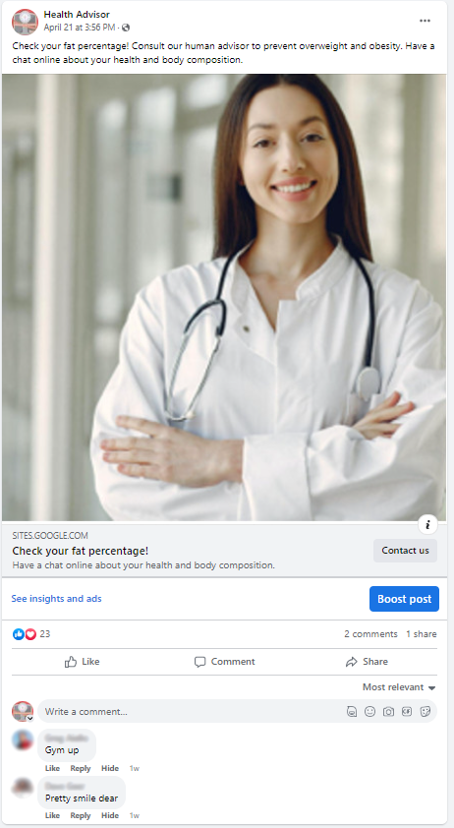
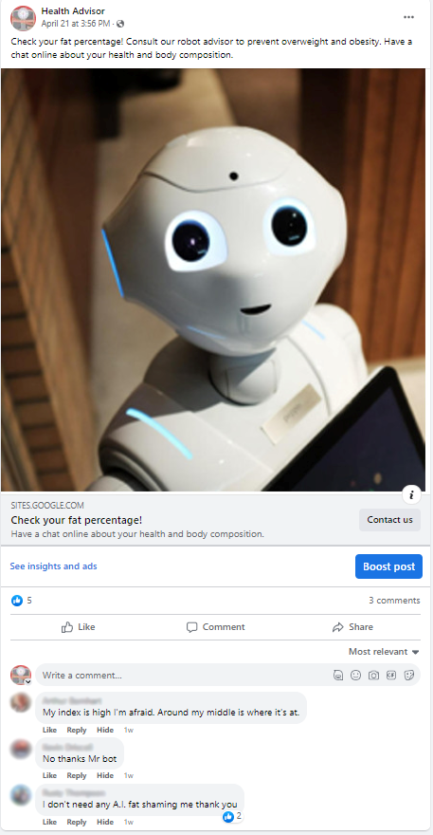

Slide 45
Case Study: Takeaways
When optimizing on clicks:
Replicated previous results
Evidence of divergent delivery
The robot ad was shown to more men than women
Men were more likely to click the robot ad
Evidence of divergent reactions
In short, OPS do not test “A” vs “B”. They test “A + optimization A + reactions A” vs “B + optimization B + reactions B”.
Is this a problem or not? When? Why?

Slide 46
Case Study: Takeaways
When optimizing on impressions or capped reach:
Very low click through rates (below industry standards)
Null results
Targeting may be optimized for users unlikely to click
No evidence of divergent delivery (but may still happen on unobservables)

Slide 47
OPS: Review of Current Practice
We reviewed and coded of all 133 OPS published in academic research (through 2023)
CTR is a dependent variable in 98% of studies, yet the exact operationalization of CTR varies significantly:
Numerator: “total clicks” vs “unique clicks”
Denominator: “reach” vs “impressions”
64% Not reported
19% preregistered

Slide 48
Review of Current Practice
Generally Desirable Practices | Generally Problematic Practices
18% - Discuss the lack of (true) randomization | 62% - Label the study as an experiment
81% - Stated purpose is to improve external/ecological validity or realism | 53% - Describe the OPS as offering (true) randomization
5% - Stated purpose is to test the combined effect of ad creatives and the algorithms delivering them | 71% - Stated purpose is to test theory
6% - Stated purpose is to learn which ad attributes work best on this platform | 74% - Use explicitly causal language

Slide 49
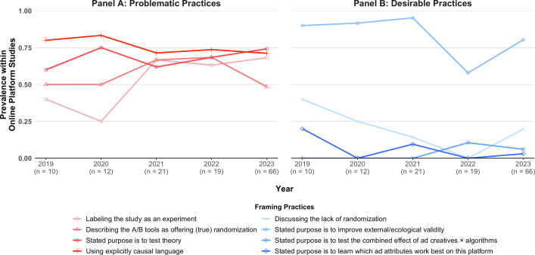

Slide 50
Online Platform Studies: Summary
OPS are one type of AB Test, but they are not a true experiment
If your goal is to learn what works best on that platform only, OPS can be great
If you want to learn more generally about your ads, customers, and products, OPS are problematic

Slide 51
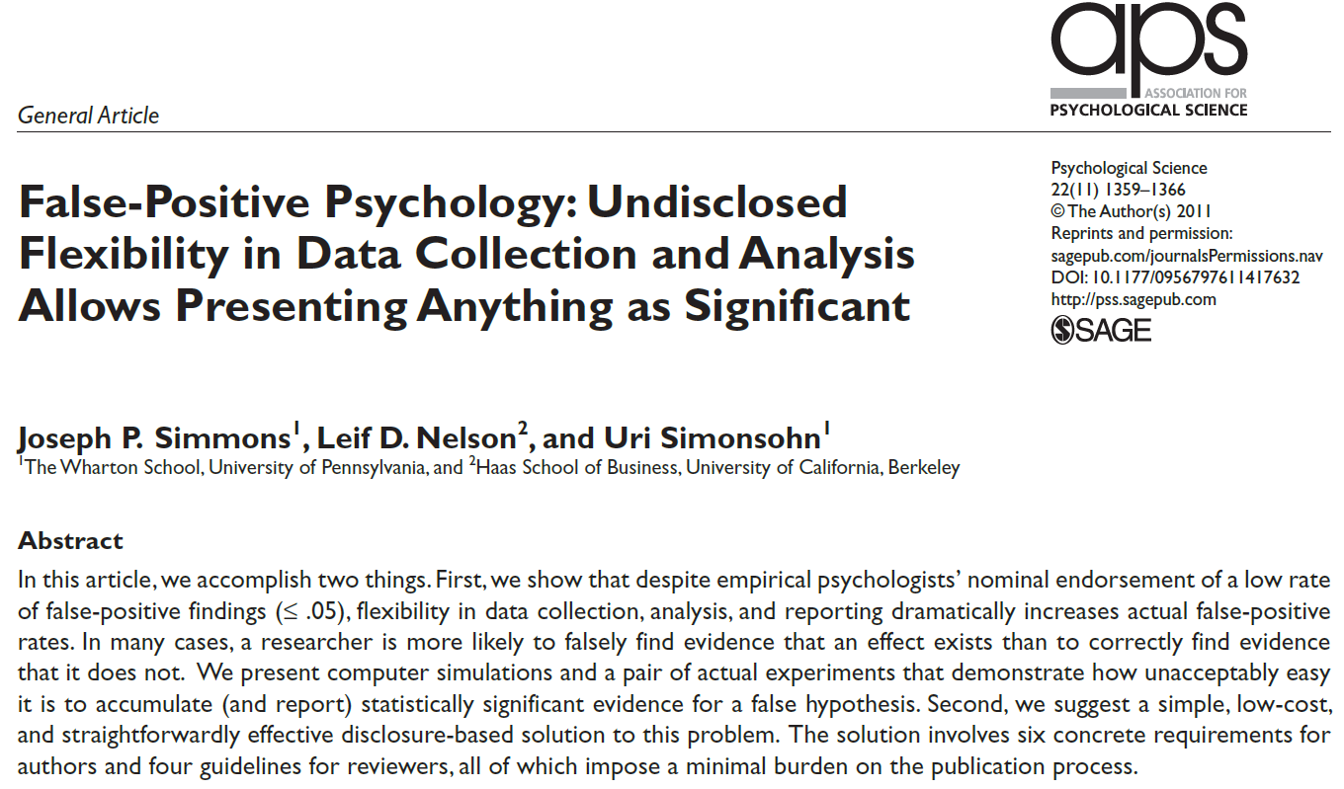

Slide 52
In practice, AB Tests often lie about p-values
the “p-value” is (roughly) the chance that we saw a difference by chance
normally we say we need p < .05 to say a result is reliable
however, people like significant results better, so people and software often use “questionable research practices” (QRPs) to make p-values lower than they should be
For example:
only reporting tests that “worked”, measures that “worked”, or subgroups that “worked”
using “one-tailed” tests
optional stopping rules for data collection
adding “covariates” to the data analysis until the key result is p<.05

Slide 53
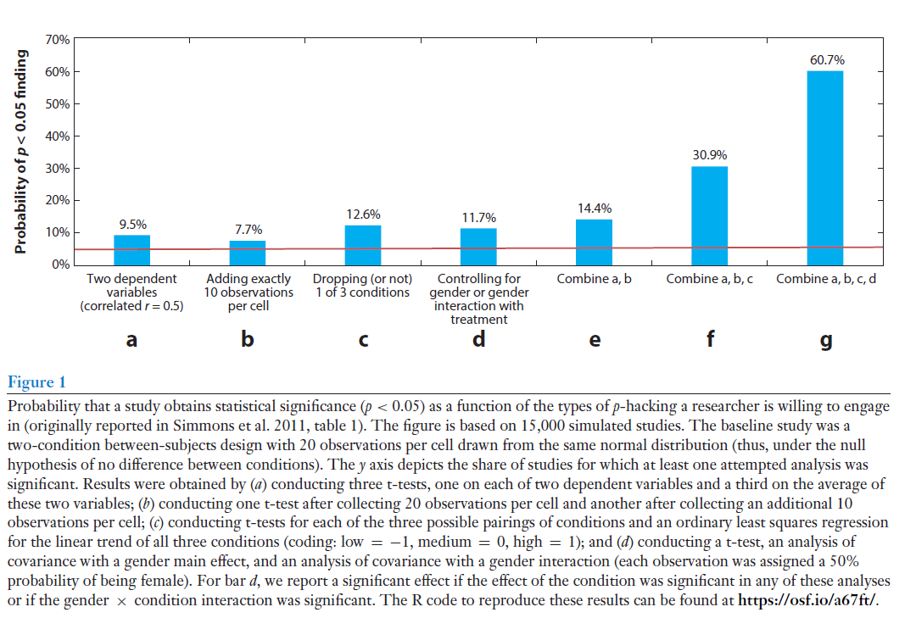
The Problem with p-values
QRP increase false positives
Probability of a false positive
Nelson, Simmons, Simonsohn 2018

Slide 54
The Problem with p-values
The Solutions
Good AB Testing Practices
Distinguish exploratory from confirmatory research (avoid HARKing: Hypothesizing After Effects are Known)
Large sample sizes
Sample size should be fixed in advance (no « optional stopping rule »)
No selective reporting of effects based on p<.05
Transparency
Be aware of the limitation of p-value analysis: in general, effect size is often more important than statistical significance, especially in applied/business contexts!!

Slide 55
Let’s look at the results of our own AB Test!

Slide 56
The future of AB Testing
Testing on AI clones of people (e.g., the “Digital Twins” project)
Using machine learning to dynamically optimize testing and scaling (“multi-dimensional bandits” -- Ba, Harrison, & Nair, working paper)
Using AI to quickly create and test ideas (e.g., book covers)

Slide 57
Key Takeaways
AB Tests can tell you: - How effective something is - Which approach is more effective - Why something is effective
The key to clean AB Testing is: - Random assignment
Be careful! AB Tests can easily be misused and miscommunicated

Slide 58
Thank you!

Slide 59
References
Braun, M., & Schwartz, E. M. (2022). The A-B Test Deception: Divergent Delivery, Response Heterogeneity, and Erroneous Inferences in Online Advertising Field Experiments. working paper, Southern Methodist University.
de Langhe, B., & Puntoni, S. (2021). Are Personalized Ads a Waste of Money? Harvard Business Review Digital Articles.
Eckles, D., Gordon, B. R., & Johnson, G. A. (2018). Field studies of psychologically targeted ads face threats to internal validity. Proceedings of the National Academy of Sciences, 115(23), E5254. doi:10.1073/pnas.1805363115
Holthöwer, J., & van Doorn, J. (2022). Robots do not judge: service robots can alleviate embarrassment in service encounters. Journal of the Academy of Marketing Science, 1-18.
Johnson, G. A. (2023). Inferno: A guide to field experiments in online display advertising. Journal of Economics & Management Strategy, forthcoming. doi:https://doi.org/10.1111/jems.12513
Kohavi, R., & Thomke, S. (2017). The surprising power of online experiments. Harvard Business Review, 95(5), 74-82.
Mosleh, M., Pennycook, G., & Rand, D. G. (2022). Field experiments on social media. Current Directions in Psychological Science, 31(1), 69-75.
Orazi, D. C., & Johnston, A. C. (2020). Running field experiments using Facebook split test. Journal of Business Research, 118, 189-198. doi:https://doi.org/10.1016/j.jbusres.2020.06.053

